Slide 1



Prescribing and adverse event reporting information can be found on the last page of this document. This is intended to be viewed as an electronic document and should not be printed
Idiopathic Multicentric Castleman Disease (iMCD)
This material is developed by Recordati Rare Diseases and is intended for use by healthcare professionals only. For more information, please contact us at:
Email: RRDUnitedKingdominfo@recordati.com Mailing address: Recordati UK Ltd. Breakspear Park, Breakspear Way, Hemel Hempstead HP2 4TZ, United Kingdom Company reg no: 09329429.
IE-SYL-0203 September 2025

Slide 2
Contents
1. Background
4. Importance of timely management
2. Pathogenesis
5. Summary
3. Diagnosis
6. UK & Ireland Prescribing Information

Slide 3
Background
01

Slide 4

CD refers to a heterogenous group of disorders that share histopathological
01 Background
features of the lymph nodes
Castleman Disease (CD) describes a group of disorders that share a spectrum of characteristic histopathological features, but have a wide range of aetiologies, presentations, treatments and outcomes^{1,2}
Castleman Disease (CD)
1
Abnormal lymphoproliferation in a single lymph node site
Abnormal lymphoproliferation in multiple lymph node sites
Unicentric CD (UCD)
Multicentric CD (MCD)
MCD caused by HHV-8*
MCD caused by a monoclonal plasma cell disorder
HHV-8 negative MCD of unknown aetiology
Multicentric Castleman Disease (MCD) is a subset of CD which has lymphadenopathy in multiple lymph node sites, and is further divided into subsets classified by driver:
HHV-8 positive MCD
POEMS
associated MCD†
Idiopathic MCD (iMCD)
1,2
Human herpesvirus-8 positive MCD (HHV-8⁺ MCD)
Polyneuropathy, Organomegaly, Endocrinopathy, Monoclonal gammopathy, Skin changes associated MCD
(POEMS-MCD)
Idiopathic MCD (iMCD) with unknown aetiology
iMCD accounts for 33–58% of published MCD cases globally¹
*Also known as Kaposi sarcoma-associated herpesvirus.
Abbreviations: CD, Castleman Disease; HHV-8, human herpesvirus-8; iMCD, idiopathic MCD; MCD, Multicentric Castleman Disease;
POEMS, polyneuropathy, organomegaly, endocrinopathy, monoclonal gammopathy, skin changes; UCD, Unicentric Castleman Disease.
References: 1. Fajgenbaum DC, et al. Blood. 2017; 129: 1646–57. 2. Dispenzieri A and Fajgenbaum DC. Blood. 2020; 135: 1353–64.

Slide 5

iMCD is a disease with low incidence that can be severe and has
a poorer prognosis than many cancers
01 Background
Idiopathic Multicentric Castleman Disease (iMCD) is a rare and life-threatening disorder^{1,2}
In a real-world, retrospective analysis, in the US:*¹
the incidence of iMCD was
3.1–3.4 cases per mil.
Patients with iMCD have poorer outcomes than many cancers including Stage II colon cancer, Stage III breast cancer, and progressive non-Hodgkin’s lymphoma²
the prevalence of iMCD was
6.9–9.7 cases per mil.
*Claims data. Given the methodology used in this study, the incidence likely reflects the incidence of individuals with a new diagnosis, and the prevalence likely reflects the prevalence of individuals with a diagnosis currently listed in their medical record.
Abbreviations: iMCD, idiopathic Multicentric Castleman Disease; US, United States.
References: 1. Mukherjee S, et al. Blood Adv. 2022; 6: 359–67. 2. Sitenga J, et al. Patient Relat Outcome Meas. 2018; 9: 35–41.

Slide 6


Patients with iMCD are difficult to identify
01 Background
iMCD patients can be
any age^{1,2}
Idiopathic Multicentric Castleman Disease (iMCD) can occur in individuals of any age, and can affect any patient population^{1,2}
Symptoms can mimic infection, autoimmune diseases, and malignancies^{2,3}
iMCD can affect any
patient population^{1,2}
Abbreviations: iMCD, idiopathic Multicentric Castleman Disease.
References: 1. Mukherjee S, et al. Blood Adv. 2022; 6: 359–67. 2. Sitenga J, et al. Patient Relat Outcome Meas. 2018; 9: 35–41.
3. Fajgenbaum DC, et al. Blood. 2017; 129: 1646–57.

Slide 7







iMCD can be a chronic disease and should be treated at the point of diagnosis^{1,2}
01 Background
A patient with iMCD will have a mix of symptoms which can look like an infection, autoimmune/autoinflammatory disease and/or malignancy*
Patients can often present with…⁴
Flu-like fever
Enlarged organs
Skin changes/ lesions
Neuropathy
Patients with idiopathic Multicentric Castleman Disease (iMCD) experience a wide range of
non-specific symptoms and laboratory abnormalities^{1,4}
Arthritis
Anaemia
Oedema
Weight loss
Some patients experience mild flu-like symptoms, however iMCD is a progressive disease which can lead to organ failure and death³⁻⁵
Example patient 1 Example patient 2
*Please note, not all iMCD patients will exhibit all of the symptoms described here. See the diagnostic guidelines for more information.
Organ failure
Abbreviations: iMCD, idiopathic Multicentric Castleman Disease.
References: 1. Sitenga J, et al. Patient Relat Outcome Meas. 2018; 9: 35-41. 2. Lang E, and van Rhee F. Blood Rec. 2024; 64: 101161. 3. van Rhee F, et al. Blood. 2018; 132: 2115–25. 4. Fajgenbaum DC, et al. Blood. 2017; 129: 1646–57. 5. Yu L, et al. Blood. 2017; 129: 1658–68.

Slide 8
Pathogenesis
02

Slide 9



iMCD is driven by a cytokine storm with an unknown cause
02 Pathogenesis
Suspected causes of iMCD…
The cytokine storm that drives idiopathic Multicentric Castleman Disease (iMCD) is hypothesised to be caused by:¹
Autoimmune/ inflammatory
Mutated monoclonal cells
Unidentified pathogen
An uncontrolled infection (pathogen hypothesis)
A germline mutation leading to an autoimmune/autoinflammatory response (autoimmune/autoinflammatory hypothesis)
Cytokine and chemokine storm
Somatic mutations in monoclonal lymph node cells (paraneoplastic hypothesis)
Adapted from Fajgenbaum DC, 2018.¹
Abbreviations: iMCD, idiopathic Multicentric Castleman Disease.
References: 1. Fajgenbaum DC. Blood. 2018; 132: 2323–30.

Slide 10
Human IL-6 is a critical driver of iMCD in some patients
02 Pathogenesis
Increased hIL-6 activity
An uninhibited dysregulation of human IL-6 (hIL-6) is a pathological driver of idiopathic Multicentric Castleman Disease (iMCD) in some patients^{1,2}
Increased VEGF
production
Plasma and B-cell overgrowth
Increased T-helper-2 cells
Inflammatory response
In severe cases, a life-threatening cytokine storm can occur, followed by organ failure and death¹
Formation of blood vessels & increased blood supply to tumour
Increases size of lymph nodes, lymphoma and myeloma
Autoimmune reactions & auto-
antibodies to organs
Systemic symptoms (increased ESR, CRP,
IgG, anaemia, DVT)
Adapted from van Rhee et al, 2010.
Abbreviations: CRP, c-reactive protein; DVT, deep vein thrombosis; ESR, eythrocyte sedimentation rate; hIL-6, human interleukin 6;
IgG, immunoglobulin G; iMCD, idiopathic Multicentric Castleman Disease; VEGF, vascular endothelial growth factor.
References: 1. van Rhee F, et al. Blood. 2018; 132: 2115–25. 2. van Rhee F, et al. Clinical Advances in Haematology & Oncology. 2010; 8: 486–98.

Slide 11

Activation of the mTOR signaling pathway has been identified in iMCD
02 Pathogenesis
The mTOR pathway
may play a key role, however more evidence is needed²
For patients where IL-6 is not a driver, recent evidence suggests a key role for activated T-cells and mammalian target of rapamycin (mTOR) pathway activation in idiopathic Multicentric Castleman Disease (iMCD)¹
While evidence suggests that the mTOR pathway may play a key role, further research is needed²
Abbreviations: IL-6, interleukin 6; iMCD, idiopathic Multicentric Castleman Disease; mTOR, mammalian target of rapamycin.
References: 1. Dispenzieri A and Fajgenbaum DC. Blood. 2020; 135: 1353–64. 2. Arenas DJ, et al. Blood. 2020; 135: 1673–84.

Slide 12
Diagnosis
03

Slide 13
Immediate and accurate diagnosis is essential but often delayed
03 Diagnosis
Autoimmune
RA/JIA
SLE
IgG4
AOSD
Diagnosis is essential to access treatment and reduce the risk of patient mortality, but diagnosis is often delayed because of the rarity of the disease and non-specific clinical symptoms¹
HLH-MAS
M-HLH ALPS
V-HLH
HL/NHL
FDC
Sarcoma
iMCD
There is significant clinical, histologic, and immunologic overlap between idiopathic Multicentric Castleman Disease (iMCD), malignancy, autoimmune, and infectious disorders, and patients are often misdiagnosed and/or may endure months without an appropriate disease management strategy²
Acute EBV
HHV-8 MCD
POEMS
Syndrome
Acute HIV
Malignancy
Infection
Adapted from Fajgenbaum et al, 2017.²
Abbreviations: ALPS, autoimmune lymphoproliferative syndrome; AOSD, adult-onset Still’s disease; EBV, Epstein-Barr virus; FDC, follicular dendritic cell; HHV-8, human herpesvirus-8;
HIV, human immunodeficiency virus; HLH-MAS, haemophagocytic lymphohistiocytosis-macrophage activation syndrome; HL/NHL, Hodgkin’s lymphoma/non-Hodgkin’s lymphoma;
IgG4; immunoglobulin G4; iMCD, idiopathic Multicentric Castleman Disease; MCD, Multicentric Castleman Disease; M-HLH, malignancy-associated haemophagocytic lymphohistiocytosis;
POEMS, polyneuropathy, organomegaly, endocrinopathy, monoclonal gammopathy, skin changes; RA/JIA, rheumatoid arthritis/juvenile idiopathic arthritis; SLE, systemic lupus erythematosus;
V-HLH, viral haemophagocytic lymphohistiocytosis.
References: 1. Sitenga J, et al. Patient Relat Outcome Meas. 2018; 9: 35–41. 2. Fajgenbaum DC, et al. Blood. 2017; 129: 1646–57.

Slide 14






Establish, add, and exclude to diagnose iMCD
03 Diagnosis
Diagnostic guidelines
Fajgenbaum DC, et al. Blood. 2017; 129: 1646–57
Diagnostic guidelines have been developed through international expert consensus to provide a framework
for idiopathic Multicentric Castleman Disease (iMCD) diagnosis¹
To confirm an accurate diagnosis of iMCD, physicians must:¹
ESTABLISH
ADD
EXCLUDE
Add at least 2 of the 11 minor criteria, including at least one laboratory abnormality
Exclude all listed conditions that can mimic iMCD
Establish both
major criteria
DIAGNOSE
See next slide for detailed diagnostic guidelines
Abbreviations: iMCD, idiopathic Multicentric Castleman Disease.
References: 1. Fajgenbaum DC, et al. Blood. 2017; 129: 1646–57.

Slide 15
Diagnostic guidelines¹
03 Diagnosis
ESTABLISH Major criteria
Multiple enlarged lymph nodes
  Measuring ≥1 cm in short-axis diameter in multiple lymph node stations
EXCLUDE
Infection-related
Exclusion criteria
HHV-8 (infection can be documented by blood PCR, diagnosis of HHV-8-associated MCD requires positive LANA-1 staining by IHC, which excludes iMCD)
Clinical EBV-lymphoproliferative disorders such as infectious mononucleosis or chronic active EBV (detectable EBV viral load not necessarily exclusionary)
Inflammation and adenopathy caused by other uncontrolled infections (e.g. acute or uncontrolled CMV, toxoplasmosis, HIV, active tuberculosis)
Histopathologic lymph node features consistent with the iMCD spectrum¹
  Requires lymph node biopsy (excisional biopsy preferred)
ADD Minor criteria
Need at least 2 of 11 minor criteria, with at least 1 laboratory parameter:
Autoimmune/autoinflammatory
Systemic lupus erythematosus
Rheumatoid arthritis
Adult-onset Still’s disease
Juvenile idiopathic arthritis
Autoimmune lymphoproliferative syndrome
Clinical symptoms
Constitutional symptoms: night sweats, fever (>38°C), weight loss or fatigue (≥2 CTCAE lymphoma score for B-symptoms)
Fluid accumulation: oedema, anasarca, ascites or pleural effusion
Large spleen and/or liver
Eruptive cherry haemangiomatosis or violaceous papules
Lymphocytic interstitial pneumonitis
Requires full clinical criteria, detection of autoimmune antibodies alone is not exclusionary
Malignant/lymphoproliferative
Lymphoma (Hodgkin’s and non-Hodgkin’s)
Multiple myeloma
Primary lymph node plasmacytoma
FDC sarcoma
POEMS syndrome (considered a disease “associated” with CD)
Laboratory parameters
Elevated CRP (>10 mg/L) or ESR (>15 mm/h)*
Anaemia (haemoglobin <12.5 g/dL for males, <11.5 g/dL for females)
Thrombocytopaenia (platelet count <150 k/μL) or thrombocytosis (platelet count <400 k/μL)
Hypoalbuminaemia (albumin <3.5 g/dL)
Renal dysfunction (eGFR <60 mL/min/1.73m²) or proteinuria (total; 150 mg/24h or 10 mg/100ml)
Polyclonal hypergammaglobulinemia (total γ globulin or immunoglobulin G >1700 mg/dL)
These disorders must be assessed at the same time as iMCD to be exclusionary
*Evaluation of CRP is mandatory, and tracking is highly recommended, but ESR is acceptable where CRP is not available
Abbreviations: CD, Castleman Disease; CMV, cytomegalovirus; CRP, C-reactive protein; CTCAE, common terminology criteria for adverse events;
EBV, Epstein-Barr virus; eGFR, estimated glomerular filtration rate; ESR, erythrocyte sedimentation rate; FDC, follicular dendritic cell; HHV-8, human herpesvirus-8;
HIV, human immunodeficiency virus; IHC, immunohistochemical staining; iMCD, idiopathic Multicentric Castleman Disease; LANA-1, latency-associated nuclear antigen;
PCR, polymerase chain reaction; POEMS, polyneuropathy, organomegaly, endocrinopathy, monoclonal gammopathy and skin changes.
References: 1. Fajgenbaum DC, et al. Blood. 2017; 129: 1646–57.

Slide 16


Diagnosis requires close multidisciplinary collaboration between pathologists
and treating physicians
03 Diagnosis
A diagnosis of idiopathic Multicentric Castleman Disease (iMCD) must include histopathologic lymph node features consistent with the iMCD spectrum which are best assessed with an excisional lymph node biopsy¹
Expert pathologists must be involved in a diagnosis of iMCD
iMCD histopathologic lymph node features
Abbreviations: iMCD, idiopathic Multicentric Castleman Disease.
References: 1. Fajgenbaum DC, et al. Blood. 2017; 129: 1646–57.

Slide 17

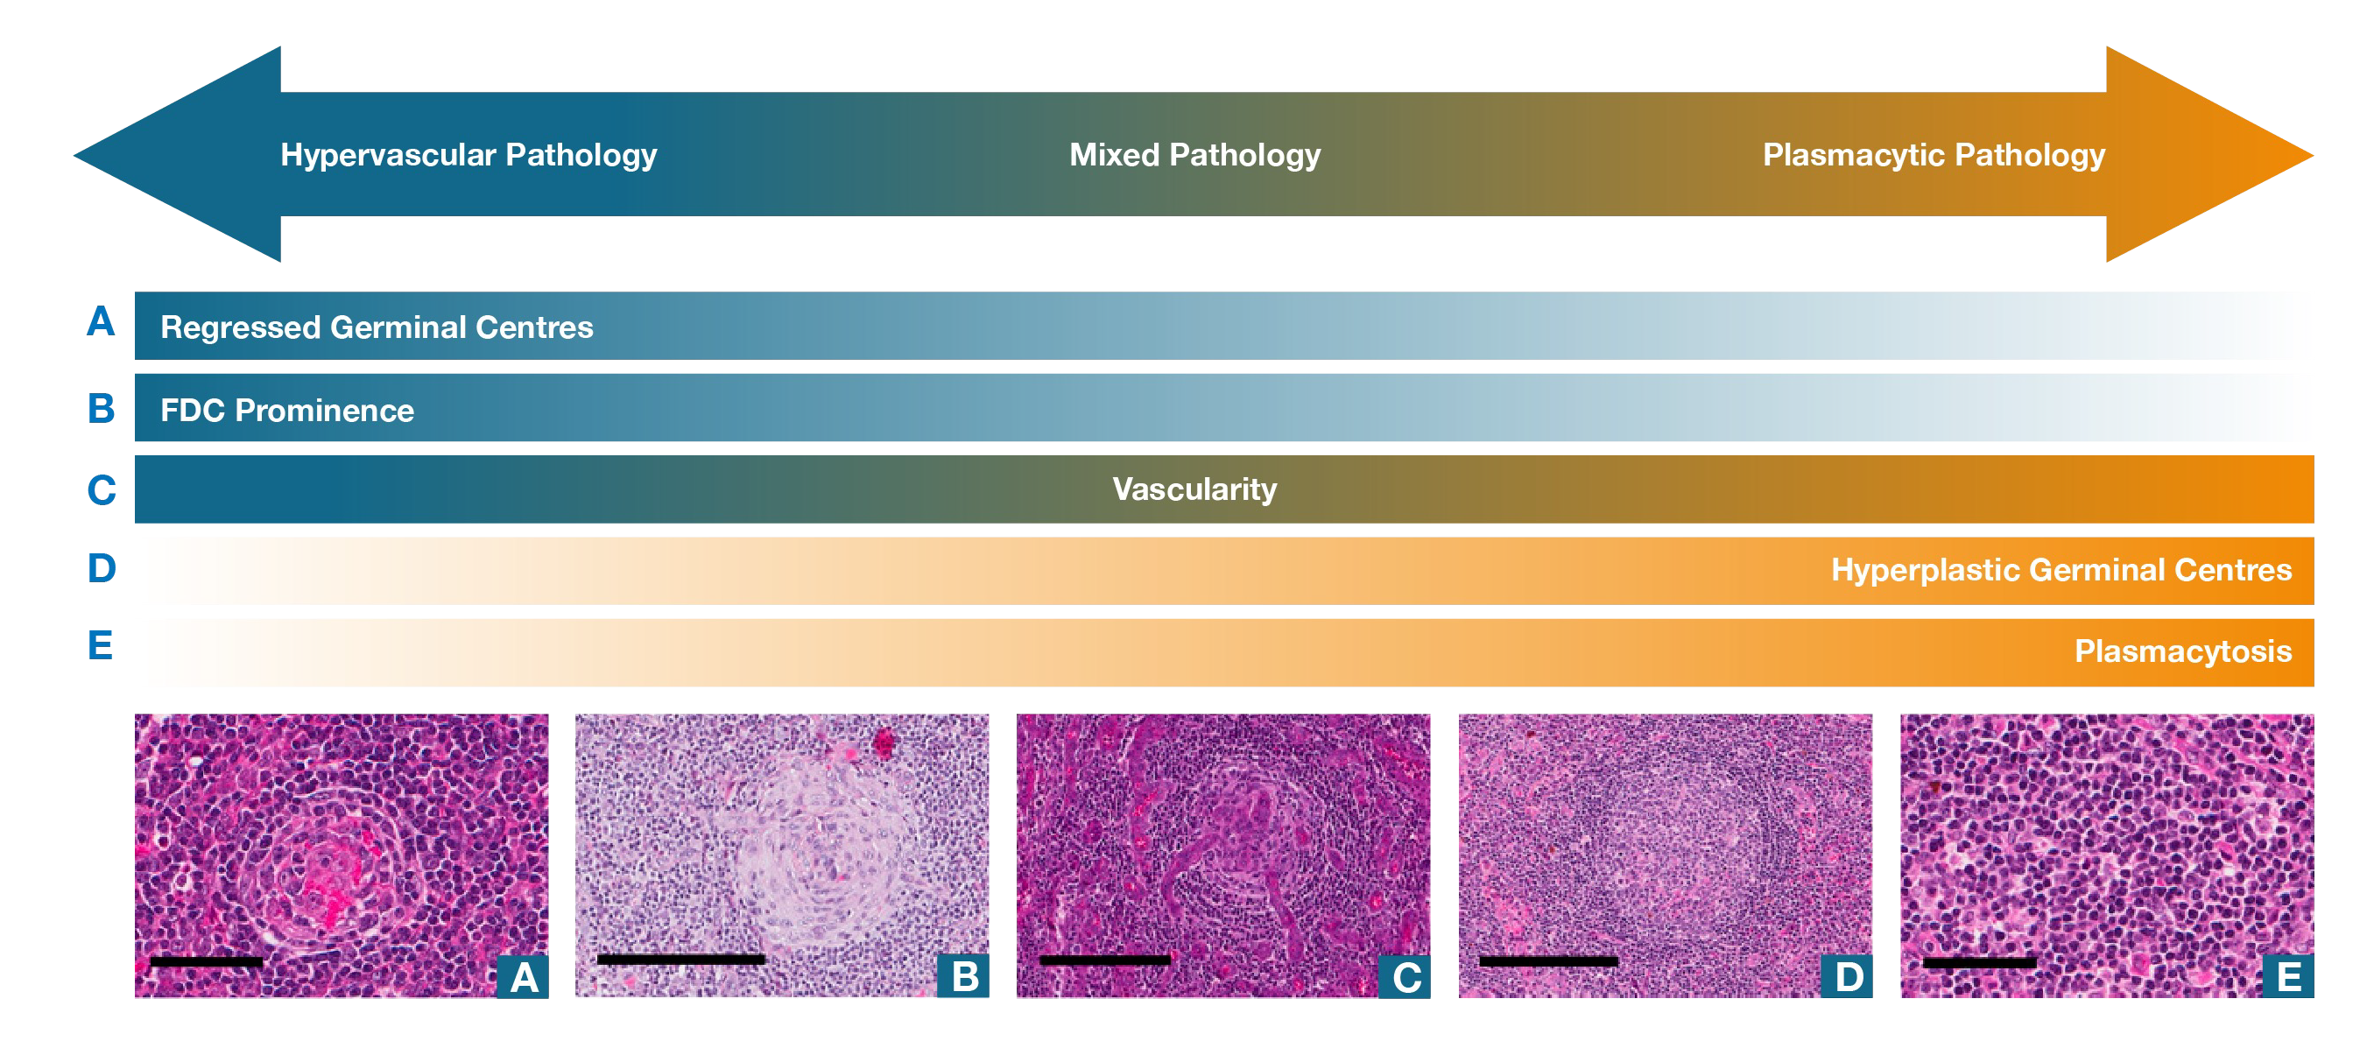


Histopathological lymph node features of Castleman Disease¹
03 Diagnosis
Diagnosis requires close multidisciplinary collaboration between pathologists and treating physicians
• A diagnosis of iMCD must include histopathologic lymph node features consistent with the iMCD spectrum which are best assessed with an excisional lymph node biopsy¹
Expert pathologists must be involved in a diagnosis of iMCD
iMCD histopathologic Click to
lymph node features^{1 see more}
Abbreviations: iMCD, idiopathic Multicentric Castleman Disease.
References: 1. Fajgenbaum DC, et al. Blood. 2017; 129: 1646–57.
Adapted from Fajgenbaum DC, et al. 2017.¹ Histopathologic features of CD. Hypervascular subtype is characterised by the presence of regressed germinal centers and FDC prominence, whereas the plasmacytic subtype exhibits hyperplastic germinal centres and profuse plasmacytosis. Mixed subtype exhibits a combination of hypervascular and plasmacytic features. Vascularity is frequently observed in iMCD, but can be seen with either subtype. Bars represent 60 μm (A,E); 200 μm (B–D).
(A) Regressed germinal center. (B) FDC prominence in germinal center. (C) Blood vessels penetrating germinal center demonstrate prominent vascularity.
(D) Hyperplastic germinal centre. (E) Sheetlike plasmacytosis.
Abbreviations: CD, Castleman Disease; FDC, follicular dendritic cell; iMCD, idiopathic Multicentric Castleman Disease.
References: 1. Fajgenbaum DC, et al. Blood. 2017; 129: 1646–57.

Slide 18
iMCD-TAFRO is a subtype of iMCD with a more aggressive clinical course^{1,2}
03 Diagnosis
Thrombocytopaenia Anasarca/ ascites
Reticulin Fibrosis
Renal dysfunction
Organomegaly
iMCD-TAFRO describes an aggressive clinical subtype of idiopathic Multicentric Castleman Disease (iMCD) involving thrombocytopaenia, anasarca/ ascites, reticulin fibrosis in bone marrow, renal dysfunction and organomegaly (TAFRO)^{1–3}
Diagnosis involves testing for intravascular coagulation and fibrinolysis as well as a bone marrow biopsy³
Abbreviations: iMCD, idiopathic Multicentric Castleman Disease; TAFRO, thrombocytopenia, anasarca/ascites, reticulin fibrosis in bone marrow, renal dysfunction, organomegaly.
References: 1. Fajgenbaum DC, et al. Blood. 2017; 129: 1646–57. 2. van Rhee F, et al. Blood. 2018; 132: 2115–25.
3. Dispenzieri A and Fajgenbaum DC. Blood. 2020; 135: 1353–64.

Slide 19
Importance of timely management
04

Slide 20
Retrospective claims analysis¹
04 Importance of timely management
Study objective
To assess…
1
…healthcare resource utilisation
2
…patterns of iMCD-related comorbidities
Retrospective, real-world analysis of claims data for…
30.7
million patients
Patients continuously enrolled over…
6.7
years
Patients with iMCD* identified…
271
patients
Average patient follow-up for…
6.7
years
*US patients, identified as having iMCD if they had an ICD-10 diagnosis code for CD (D47.Z2) and ≥2 diagnostic or laboratory claims corresponding to the minor criteria from the international evidence-based consensus diagnostic criteria for iMCD. Exclusion criteria included history of HIV, HHV-8, HL/NHL, myeloma, lupus, or rheumatoid arthritis within one year of diagnosis of CD. Index Diagnosis Date (IDD) was defined as the first time a patient received a diagnosis for CD using the new ICD-10 code (D47.Z2) or the general code for lymphadenopathy (785.6) in ICD-9-CM that included CD (whichever was diagnosed first).
Abbreviations: CD, Castleman Disease; HHV-8, human herpesvirus-8; HIV, human immunodeficiency virus; HL/NHL, Hodgkin’s lymphoma/non-Hodgkin’s lymphoma; ICD-9-CM, International Classification of Diseases, 9th Revision, Clinical Modification; ICD-10, International Classification of Diseases 10th revision; IDD, index diagnosis date; iMCD, idiopathic Multicentric Castleman Disease; US, United States.
References: 1. Mukherjee S, et al. Leukemia. 2022; 36: 2539–43.

Slide 21



iMCD has a poorer prognosis than many cancers and should be treated at the point of diagnosis^{1,2}
04 Importance of timely management
Patients with idiopathic Multicentric Castleman Disease (iMCD) have poorer outcomes than many cancers including Stage II colon cancer, Stage III breast cancer, and progressive non-Hodgkin’s lymphoma¹
Before the era of targeted treatment, approximately
35%
of patients died within five years of diagnosis³
Abbreviations: iMCD, idiopathic Multicentric Castleman Disease.
References: 1. Sitenga J, et al. Patient Relat Outcome Meas. 2018; 9: 35–41. 2. Lang E, and van Rhee F. Blood Rev. 2024; 64: 101161.
3. Fajgenbaum DC, et al. Blood. 2017; 129: 1646–57.

Slide 22


iMCD has a severe and rapid impact on patient quality of life
04 Importance of timely management
Annual inpatient hospitalisations and ER visits for patients with iMCD within the first two years
of diagnosis¹
100
Annual percentage of patients (%)
First year of diagnosis Second year of diagnosis
In a real-world, retrospective analysis of claims data, inpatient hospital stays for at least 5 days were observed for 15.6% of patients with idiopathic Multicentric Castleman Disease (iMCD) in the first year of diagnosis, and dropped to 5.2% in the subsequent year¹
80
60
42.6%
40
A similar pattern was observed for emergency-room (ER) visits; 42.6% of patients with iMCD required an ER visit within the first year of diagnosis, before dropping to 13.5% in the second year after diagnosis¹
20
15.6%
13.5%
5.2%
0
Inpatient hospitalisations
Emergency-room visits
Adapted from Mukherjee et al., 2022.¹
Abbreviations: ER, emergency room; iMCD, idiopathic Multicentric Castleman Disease.
References: 1. Mukherjee S, et al. Leukemia. 2022; 36: 2539–43.

Slide 23
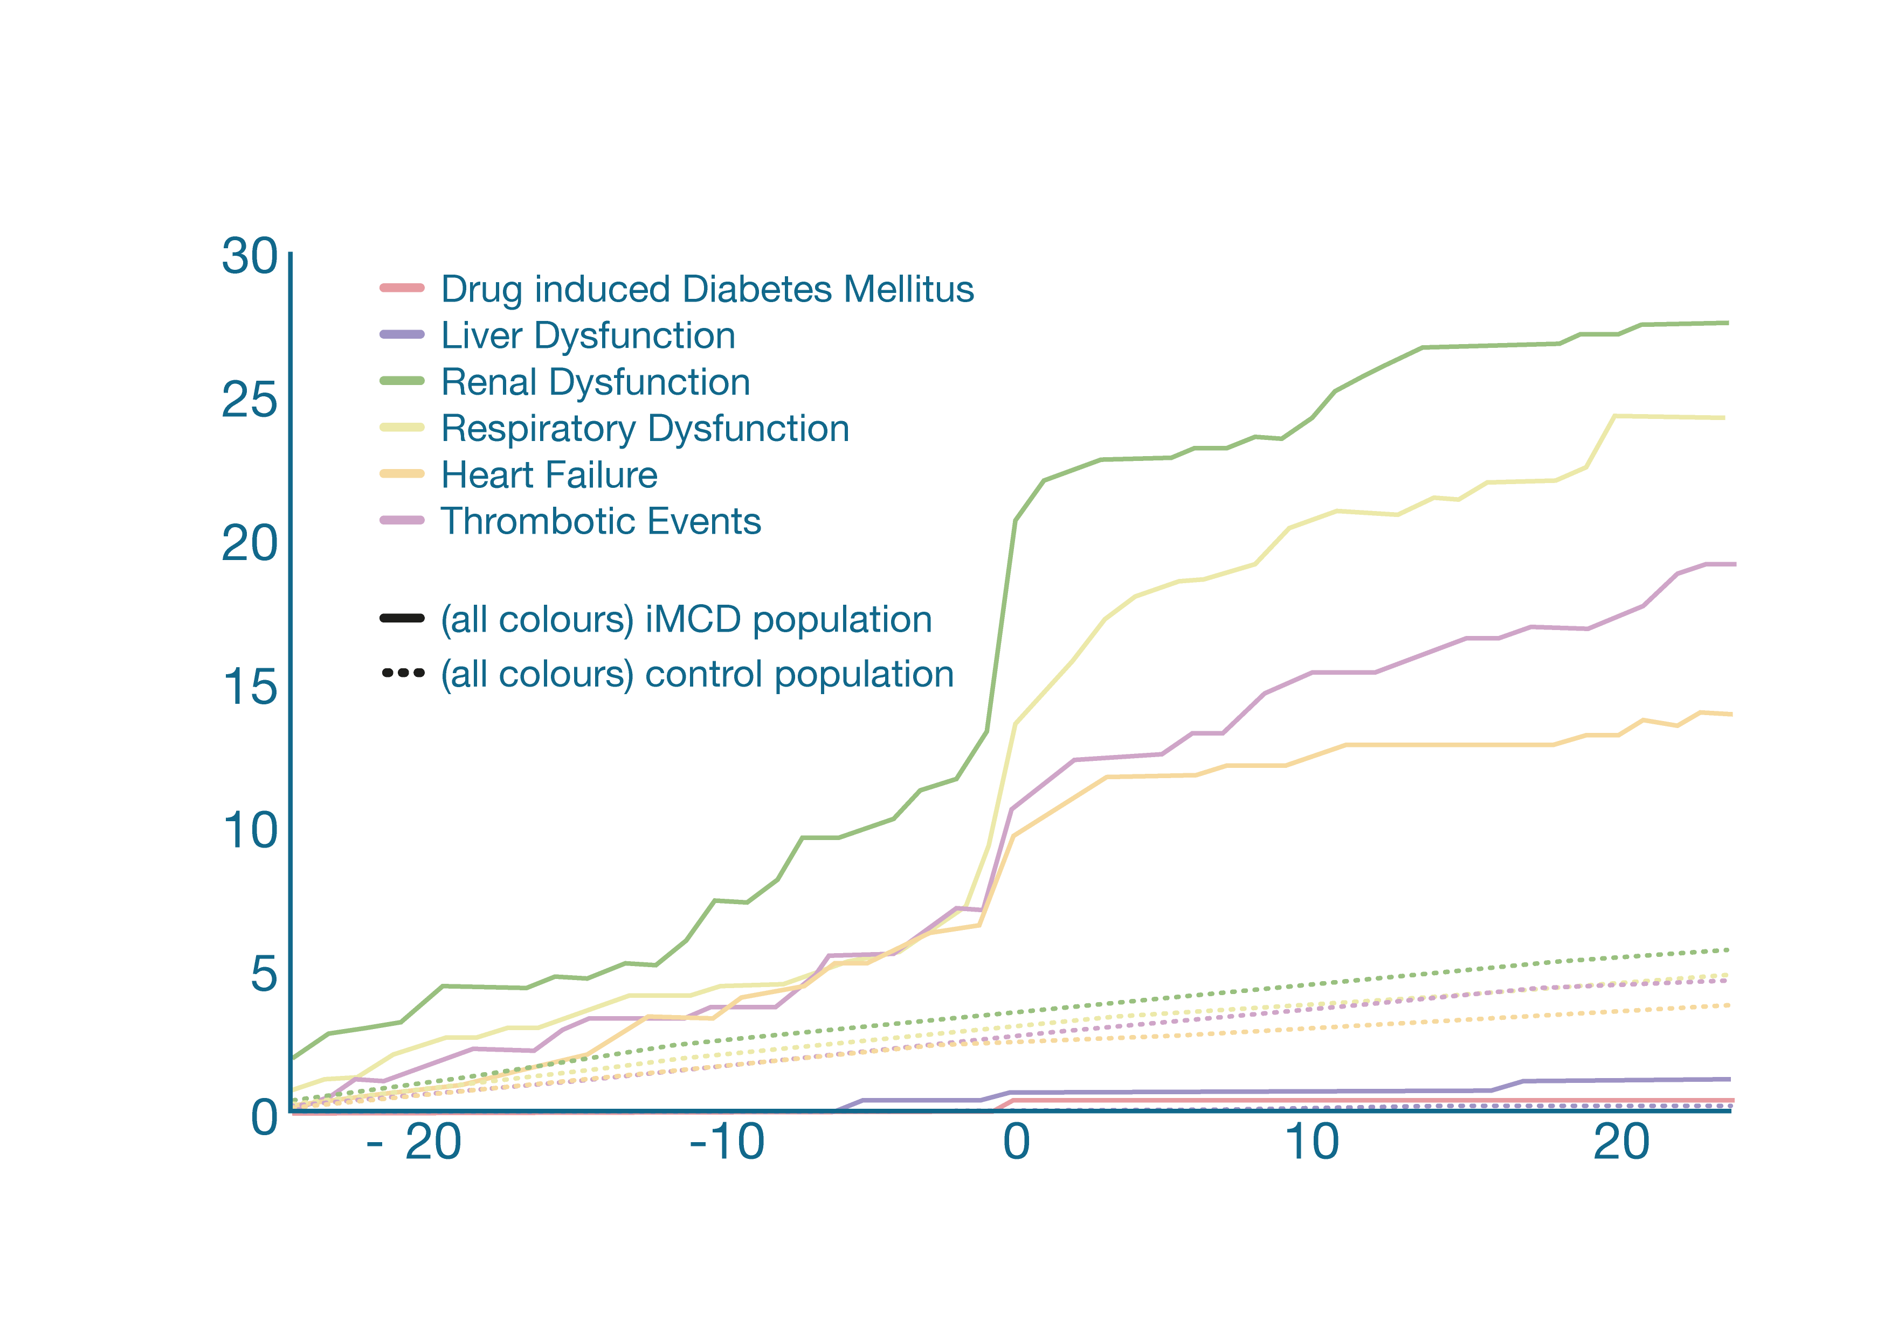
Patients with iMCD have a high risk of serious comorbidities
04 Importance of timely management
Cumulative proportion of organ dysfunction and thrombotic events were higher in patients
with iMCD vs. controls¹
In a real-world, retrospective analysis of US claims data, a significantly higher proportion of patients with idiopathic Multicentric Castleman Disease (iMCD) presented with organ failure and/or thrombotic events, compared with
a non-iMCD matched cohort, (P<0.001)¹
Among all organ dysfunction-related morbidities, renal and respiratory function were affected the most, in the cohort of patients with iMCD¹
Cumulative patients (%)
Months from index (diagnosis) date
Adapted from Mukherjee et al., 2022.¹
Abbreviations: iMCD, idiopathic Multicentric Castleman Disease; US, United States.
References: 1. Mukherjee S, et al. Leukemia. 2022; 36: 2539–43.

Slide 24
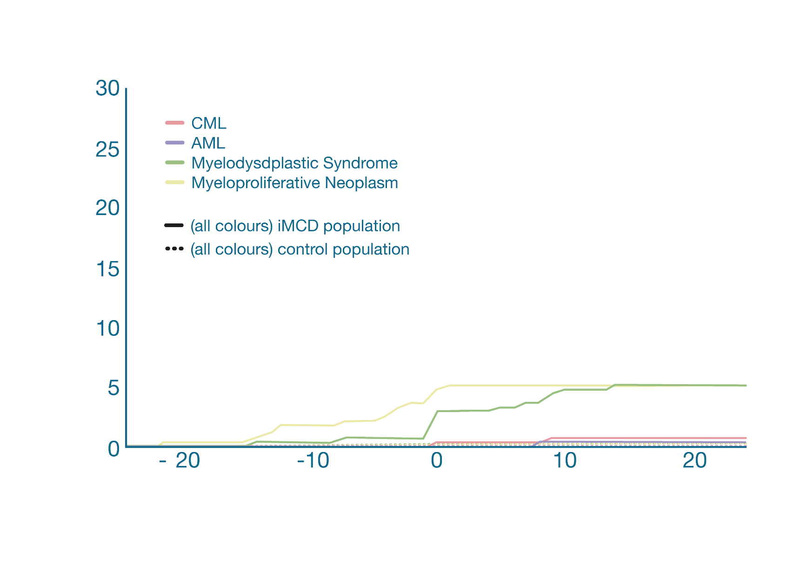
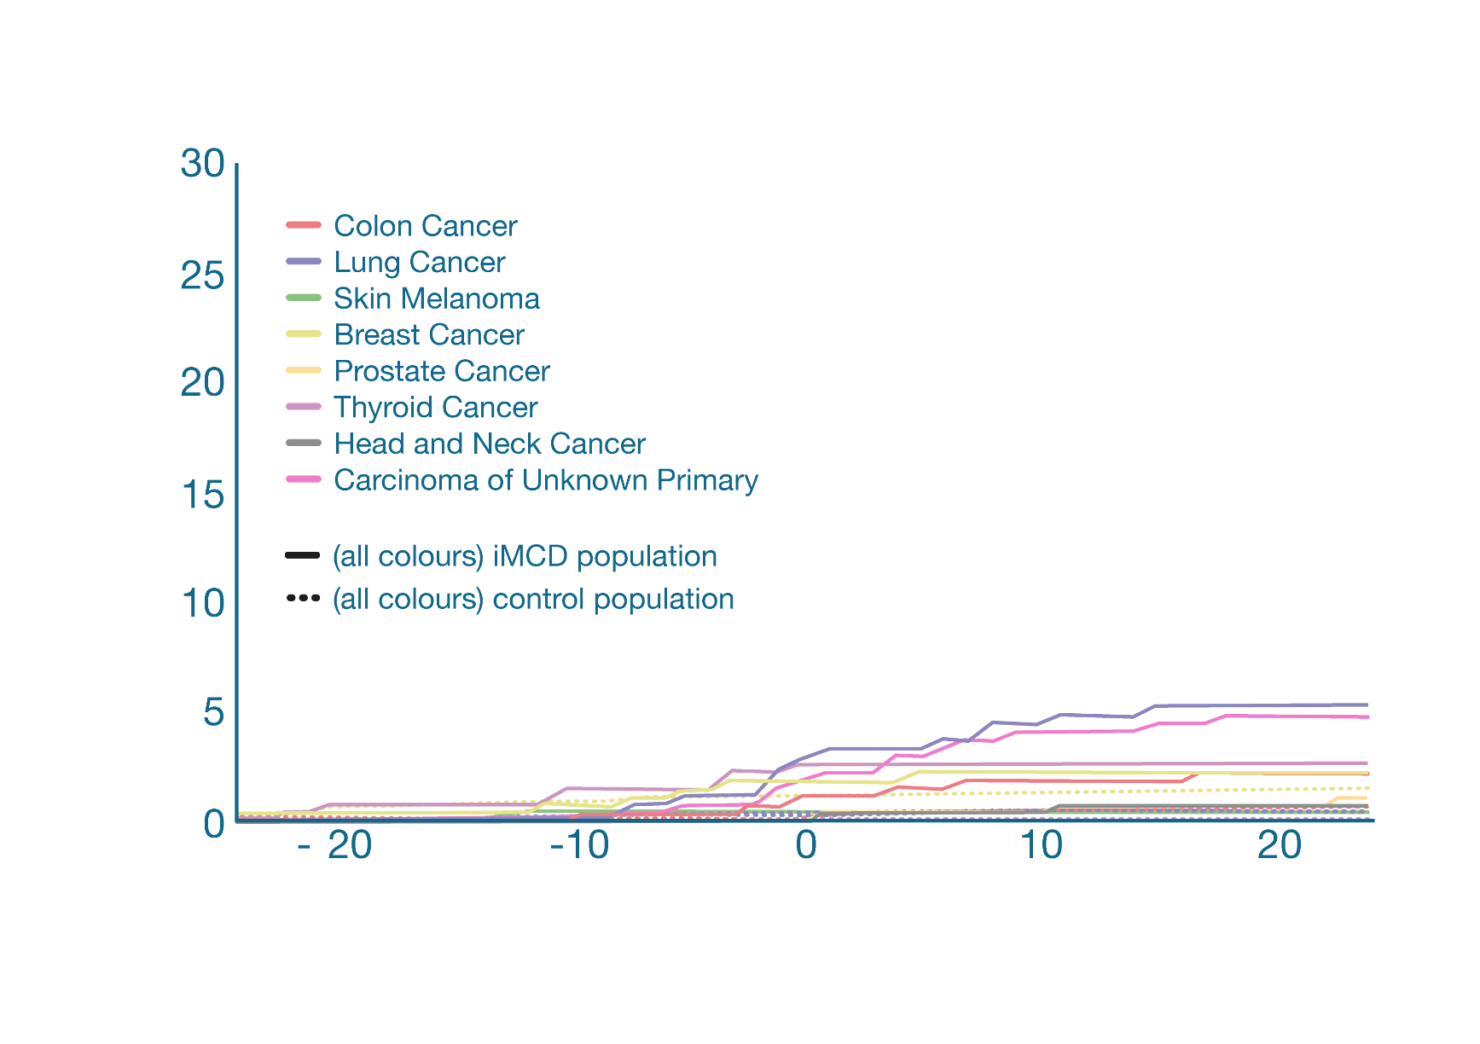
Increased prevalence of malignancies in patients with iMCD
04 Importance of timely management
Cumulative proportion of myeloid and solid malignancies were higher in patients with iMCD vs. controls¹
Myeloid malignancies
Cumulative patients (%)
In a real-world, retrospective analysis of US claims data, patients with idiopathic Multicentric Castleman Disease (iMCD) had significantly higher prevalence of myeloid and solid malignancies, compared with a non-iMCD matched cohort, (P<0.001)¹
Months from index (diagnosis) date
Among all myeloid malignancies, myelodysplastic syndrome, and myeloproliferative neoplasm, accounted for the highest proportion of cases; carcinoma of unknown primary accounted for the most cases of solid malignancies in iMCD patients¹
Cumulative patients (%)
Solid malignancies
Months from index (diagnosis) date
Abbreviations: AML, acute myeloid leukemia; CML, chronic myeloid leukemia; iMCD, idiopathic Multicentric Castleman Disease; US, United States.
References: 1. Mukherjee S, et al. Leukemia. 2022; 36: 2539–43.

Slide 25
iMCD is a chronic disease that progresses in the absence of an appropriate management strategy
04 Importance of timely management
Potentially severe
Idiopathic Multicentric Castleman Disease (iMCD) is a chronic disease that progresses in the absence of treatment and can lead to severe symptoms such as organ dysfunction and death^{1–3}
iMCD
Chronic
Progressive
Abbreviations: iMCD, idiopathic Multicentric Castleman Disease; US, United States.
References: 1. van Rhee F, et al. Blood. 2018; 132: 2115–25. 2. Fajgenbaum DC. Blood. 2018; 132: 2323–30. 3. Yu L, et al. Blood. 2017; 129: 1658–68.

Slide 26
Summary
05

Slide 27
01 Background
02 Pathogenesis
CD refers to a heterogenous group of disorders that share histopathological features of the lymph nodes¹
iMCD is driven by a cytokine storm with an unknown cause⁶
Human IL-6 is a critical driver of iMCD in some patients^{4,7}
iMCD is a rare and severe disease with a poorer prognosis than many cancers²
Activation of the mTOR signaling pathway has been identified in iMCD⁸
Patients with iMCD are difficult to identify^{2,3}
iMCD is a severe and progressive disease which should be treated at the point
of diagnosis¹⁻⁵
Abbreviations: CD, Castleman Disease; IL-6, interleukin 6; iMCD, idiopathic Multicentric Castleman Disease; mTOR, mammalian target of rapamycin.
References: 1. Fajgenbaum DC, et al. Blood. 2017; 129: 1646–57. 2. Sitenga J, et al. Patient Relat Outcome Meas. 2018; 9: 35–41. 3. Mukherjee S, et al. Leukemia.
2022; 36: 2539–43.. 4. van Rhee F, et al. Blood. 2018; 132: 2115–25. 5. Lang E, and van Rhee F. Blood Rev. 2024; 64: 101161. 6. Fajgenbaum D. Blood. 2018; 132:
2323–30. 7. van Rhee F, et al. Clinical Advances in Haematology & Oncology. 2010; 8: 486–98. 8. Dispenzieri A and Fajgenbaum DC. Blood. 2020; 135: 1353–64.

Slide 28
Importance of timely management
03 Diagnosis
04
Immediate and accurate diagnosis is essential but often delayed¹
iMCD has a poorer prognosis than many cancers and should be treated at the point of diagnosis³⁻⁵
Diagnostic guidelines have been developed through international expert consensus to provide a framework for iMCD diagnosis¹
iMCD is not an indolent disease^{3,5}
iMCD is a severe and progressive disease which requires timely management⁴
Diagnosis requires close multidisciplinary collaboration between pathologists and treating physicians¹
iMCD is a chronic disease that progresses in the absence of an appropriate management strategy⁶⁻⁸
iMCD-TAFRO is a subset of iMCD with a more aggressive clinical course^{1,2}
Abbreviations: iMCD, idiopathic Multicentric Castleman Disease; TAFRO, thrombocytopenia, anasarca/ascites, reticulin fibrosis in bone marrow, renal dysfunction, organomegaly.
References: 1. Fajgenbaum DC, et al. Blood. 2017; 129: 1646–57. 2. Dispenzieri A and Fajgenbaum DC. Blood. 2020; 135: 1353–64.
3. Sitenga J, et al. Patient Relat Outcome Meas. 2018; 9: 35–41. 4. Mukherjee S, et al. Leukemia. 2022; 36: 2539–43. 5. Lang E, and van Rhee F. Blood Rev. 2024; 64:
101161. 6. van Rhee F, et al. Blood. 2018; 132: 2115–25. 7. Fajgenbaum DC. Blood. 2018; 132: 2323–30. 8. Yu L, et al. Blood. 2017; 129: 1658–68.

Slide 29
UK & IRELAND PRESCRIBING INFORMATION
SYLVANT®(siltuximab) 100mg and 400mg powder for concentrate for solution for infusion
Prescribers should refer to the Summary of Product Characteristics before prescribing.
PRESENTATION: Siltuximab, 100 mg or 400 mg freeze-dried white powder for concentrate.
INDICATION: Treatment of adult patients with multicentric Castleman’s disease (MCD) who are human immunodeficiency virus (HIV) negative and human herpesvirus- 8 (HHV8) negative. POSOLOGY & ADMINISTRATION: This medicinal product should be administered by qualified healthcare professionals and under appropriate medical supervision. Adults: Recommended dose 11mg/kg siltuximab given over 1 hour as an intravenous infusion administered every 3 weeks until treatment failure. Haematology laboratory tests should be performed prior to each dose for first 12 months, then every third cycle. Consider delaying treatment if: absolute neutrophil count <1.0x10⁹/L; platelet count <75x10⁹/L for first administration or <50x10⁹/L for subsequent administration; or haemoglobin ≥170g/L (10.6 mmol/L). Withhold treatment if severe infection or any severe non-haematological toxicity. Restart at the same dose after recovery. Discontinue if severe infusion-related reaction, anaphylaxis, severe allergic reaction or cytokine release syndrome. Consider discontinuation if more than 2 dose delays due to treatment-related toxicities during first 48 weeks. SPECIAL POPULATIONS: Elderly Patients: No dose adjustment required. Renal & Hepatic impairment: No studies. Paediatric population: The safety and efficacy of siltuximab in children aged 17 years and younger has not been established. No data available. CONTRAINDICATIONS: Severe hypersensitivity to active substance or any excipient. SPECIAL WARNINGS & PRECAUTIONS: Traceability: In order to improve the traceability of biological medicinal products, the tradename and the batch number of the administered product should be clearly recorded. Concurrent active serious infections: Infections, including localised infections, should be treated prior to administering SYLVANT. Serious infections, including pneumonia and sepsis, were observed during clinical studies. Hypoglobulinaemia was observed in 4% to 11.3% of patients in the clinical study. Two cases of reactivated hepatitis B have been reported on concomitant use with high dose dexamethasone, and bortezomib, melphalan and prednisone. Monitor for serious infections as SYLVANT may mask signs and symptoms of acute inflammation, including suppression of fever and acute-phase reactants such as C-reactive protein (CRP). Vaccinations: Do not administer live, attenuated vaccines concurrently or within 4 weeks prior to initiating SYLVANT. Lipid parameters: Triglyceride and cholesterol elevations observed, manage as per current guidelines for hyperlipidaemia. Infusion reactions and hypersensitivity: Mild to moderate infusion reactions may improve following slowing of or stopping the infusion. Upon resolution, reinitiating the infusion at a lower infusion rate and therapeutic administration of antihistamines, paracetamol, and corticosteroids may be considered. Discontinue in patients who have severe infusion related hypersensitivity reactions (e.g., anaphylaxis).The management of severe infusion reactions should be dictated by the signs and symptoms of the reaction. Appropriate personnel and medicinal product should be available to treat anaphylaxis if it occurs. Malignancy: Immunomodulatory medicinal products may increase the risk of malignancy. On the basis of limited experience with siltuximab the present data do not suggest any increased risk of malignancy. Gastrointestinal perforation: Gastrointestinal (GI) perforation has been reported in siltuximab clinical trials. Use with caution in patients at increased risk of GI perforation. Promptly evaluate patients presenting with symptoms that may be associated with or suggestive of GI perforation. Hepatic impairment: Transient or intermittent mild to moderate elevation of hepatic transaminase levels or other liver function tests have been reported. Monitor patients with known hepatic impairment or elevated transaminase or bilirubin levels. INTERACTIONS: Binding bioactive IL-6 by siltuximab may result in increased metabolism of CYP450 substrates. It is recommended to monitor the effect or concentration of CYP450 substrates that have a narrow therapeutic index (e.g., warfarin, cyclosporine or theophylline). Exercise caution when siltuximab is co-administered with medicinal products that are CYP3A4 substrates where a decrease in effectiveness would be undesirable (e.g., oral contraceptives). WOMEN OF CHILDBEARING POTENTIAL: Effective contraception must be used during and up to 3 months after treatment. PREGNANCY: Not recommended. BREAST-FEEDING: No data. Risk to newborn / infant cannot be excluded. FERTILITY: Effects on fertility have not been evaluated in humans. ADVERSE REACTIONS: Very common (≥1/10): Upper respiratory tract infection, urinary tract infection, nasopharyngitis, neutropenia, thrombocytopenia, hypertriglyceridaemia, hyperuricaemia, dizziness, headache, oropharyngeal pain, hypertension, nausea, abdominal pain, vomiting, constipation, diarrhoea, gastroesophageal reflux disease, mouth ulceration, rash, pruritus, eczema, arthralgia, pain in extremity, renal impairment, localised oedema, weight increased. Common (≥1/100 to <1/10): Anaphylactic reaction, hypercholesterolaemia. Prescribers should refer to the summary of product characteristics in relation to other adverse reactions. LEGAL CLASSIFICATION: POM. PRESENTATIONS, PACK SIZES, MARKETING AUTHORISATION NUMBER(S): SYLVANT 100 mg powder for concentrate for solution for infusion, 1 vial per pack: PLGB 44185/0006 (UNITED KINGDOM), EU/1/14/928/001 (REPUBLIC OF IRELAND). SYLVANT 400mg powder for concentrate for solution for infusion, 1 vial per pack: PLGB 44185/0007 (UNITED KINGDOM), EU/1/14/928/002 (REPUBLIC OF IRELAND). UK BASIC NHS COST: SYLVANT 100 mg powder for concentrate for solution for infusion, 1 vial per pack: £502.15. SYLVANT 400mg powder for concentrate for solution for infusion, 1 vial per pack: £2009.81. MARKETING AUTHORISATION HOLDER (UNITED KINGDOM): Recordati UK Ltd., Breakspear Park, Breakspear Way, Hemel Hempstead, HP2 4TZ, United Kingdom. MARKETING AUTHORISATION HOLDER (REPUBLIC OF IRELAND): Recordati Netherlands B.V., Beechavenue 54, 1119PW Schiphol-Rijk, Netherlands. FURTHER INFORMATION IS AVAILABLE UPON REQUEST FROM: Recordati UK Ltd, Breakspear Park, Breakspear Way, Hemel Hempstead, HP2 4TZ, United Kingdom. DATE PRESCRIBING INFORMATION LAST REVISED: December 2024 (version 3.0).
Adverse events should be reported. (UK) Reporting forms and information can be found at https://yellowcard.mhra.gov.uk/. (Ireland) Healthcare professionals are requested to report suspected adverse reactions to HPRA via their website https://www.hpra.ie/. Adverse events should also be reported to Recordati UK Ltd by telephone: +44 (0)1491 414 333 or email: RRDpharmacovigilance@recordati.com.
Notes:
DO NOT MODIFY THIS SLIDE. DO NOT MODIFY THE TEXT, FORMATTING OR LAYOUT.

Slide 30
The end

